Slide 1
WAF Penn Athletics
Final Presentation
April 27, 2023

Slide 2
Agenda
Team Introduction
Timeline Review
Framework Overview
Approach
Preliminary Output
Next Steps

Slide 3







Team Introduction
Matthew Thwaites
Engagement Lead
MBA’25
Yue Chen
Technical Lead
ENG’23, DS
Jason Wang
Senior Analyst
CAS’24 Biophysics
Andrew Yang
Senior Analyst
CAS’25, Psychology
Your photo here
Aeshon Balasubramanian
Junior Analyst
ENG’26, CIS
Kai Wang
Junior Analyst
ENG’26 Systems Engineering
Andrew Mao
Junior Analyst
WH’26 ENG’26 M&T

Slide 4
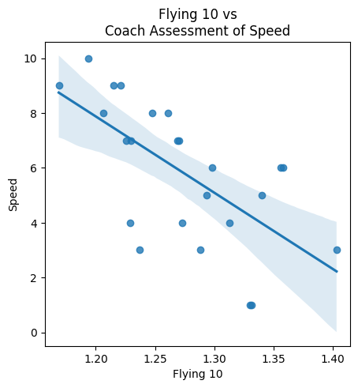
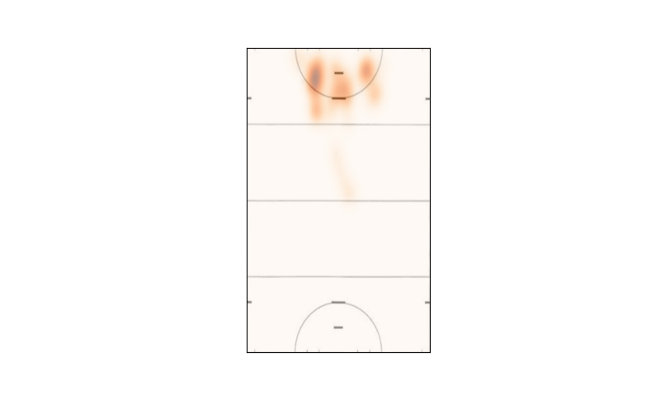
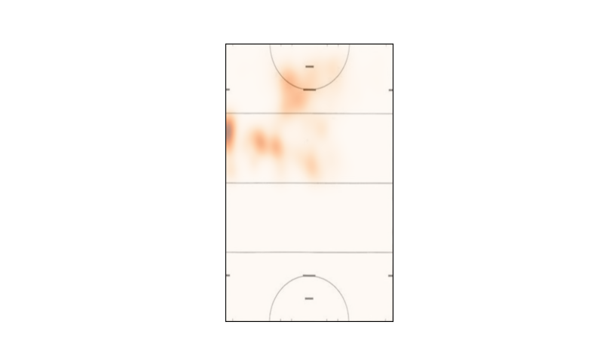
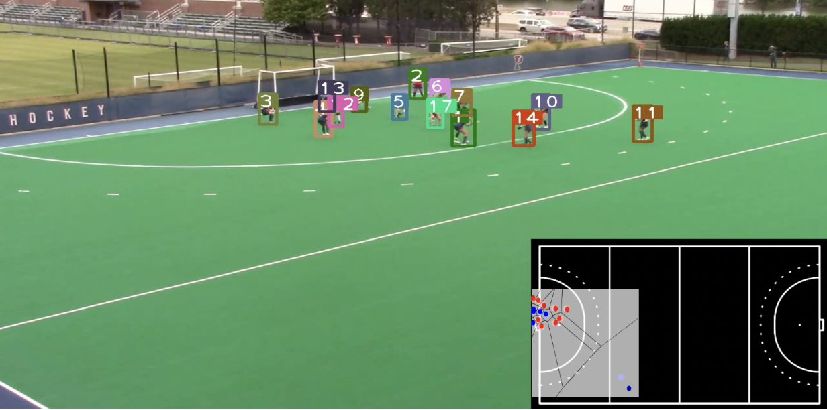
Penn Athletics | Project Overview
PHASE I
Coaching Assessments & Physical Training
Data Source: Coach Assessment
PHASE II
Player GPS Data &
Critical Events
Data Source: GPS
PHASE III
Computer Vision & In-Game Strategy
Data Source: In-Game Footage
APPROACH
Coaches accurately estimate team and players’ physical stats, even without complete data
Coaches planning to increase endurance-based exercises and assessments
Goals mainly come from ‘top of the circle’
‘Set Plays’ from corners have higher p of scoring than ‘Open Plays’
Circle Entries disproportionately from ‘top of the circle’
Penn dominates outside areas prior to penalties - creating opportunities for passing and controlling the ball
‘Circle Entry’ patterns lead to the highest goal rates
KEY TAKEAWAYS
Notes:
show goal location
fix the graphs with colors and areas of domination
heat maps and images for set plays
possible MP4s of the set plays

Slide 5
Major Project Timeline: Breakdown
Phase 1: Training & Coach Assessment Data Analysis
5 weeks
Phase 2: GPS & Game Data Analysis
5 weeks
Week 0-2
Data Preprocessing & Exploration
Week 3
Correlation Analysis
Week 5
Preliminary Results
Week 6-7
GPS & Goals Analysis
Week 8
Analysis Finalization
Week 9-10
Final Presentation & Wrap-up
Received GPS & training data at week 2
Clean and join GPS with training data
Extract useful features from GPS data
Received coach assessment & player stats data
Find correlations between training, coach assessment, and player performance
Find factors in players training contributing to coach’s assessment
Visualize important GPS features
Receive data player and timestamp of goal shot
Analyze the player’s behavior before a goal is scored
Combine results from GPS analysis and training analysis
Convert results into actionable items for PennAthletics and coaches
Present final results
Hand over analysis framework and files to PennAthletics
Notes:
Flora

Slide 6
Project Overview
Objective: use Penn Athletics data to better inform coaches on training and game strategy
Physical Training
Flying 10, Beep Test, 5-10-5,etc.
Coach Assessment
Speed, Endurance, Strength, etc.
Player Stats
Goals, Minutes Played, etc
Player GPS data
Coordinates, speed, etc.
What factors are coach assessments based on?
Does player performance reflect coach assessment?
What are player’s behaviors before goals?
Recommendations to coaches on assessing and training players
Recommendations to coaches on choosing player’s positions based on their abilities
Notes:
Flora

Slide 7
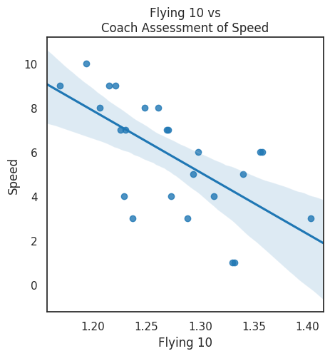
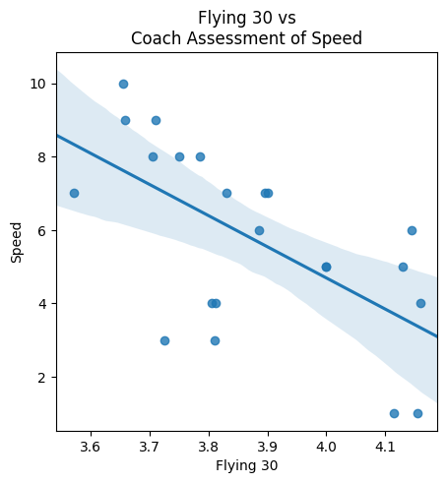
Phase I: Coach Assessment - Speed
Top Predictors for Speed:
Flying 10
Flying 30
5-0-5 Right
Corr: -0.647
Corr: -0.614
Coach’s assessment of speed is heavily influenced by short sprint exercises, rather than speed-endurance exercises.
Notes:
show the top predictors on x and predicted coaches assessment on y
1-3 sentences of takeaway per slide
show r2
used regression to see which exercises predict coach assessment the most.

Slide 8
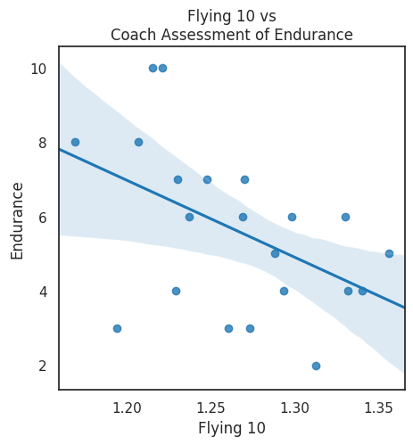
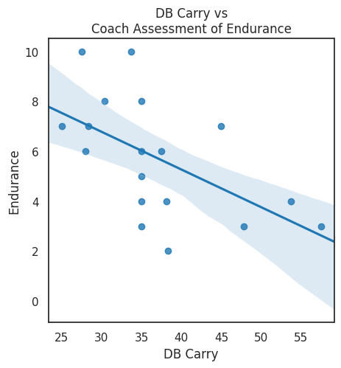
Phase I: Coach Assessment - Endurance
Top Predictors for Endurance:
DB Carry
Flying 10
Broad Jump
Corr: -0.475
Corr: -0.562
We find the endurance assessment negatively correlated with exercises on speed since there are not enough results from SnC exercises designed to strongly measure endurance. For example, only 8 out of 25 athletes took the beep test.

Slide 9
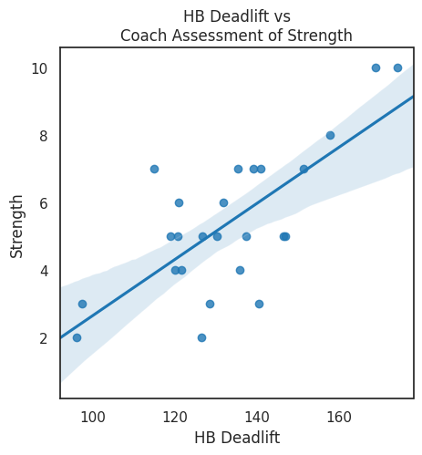
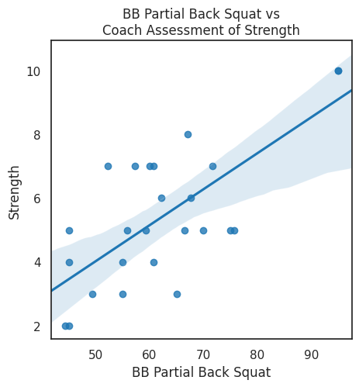
Phase I: Coach Assessment - Strength
Top Predictors for Strength:
HB Deadlift
BB Partial Back Squat
BB Hang Power Clean
Corr: 0.725
Corr: 0.712
Coach’s assessment of strength is heavily influenced by traditional strength tests.

Slide 10
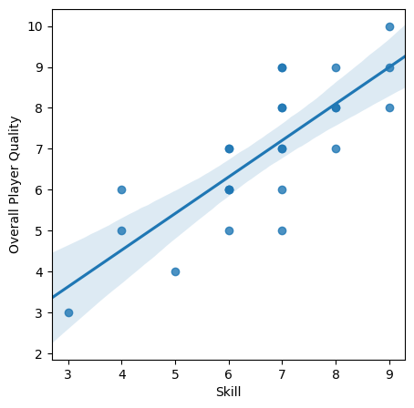
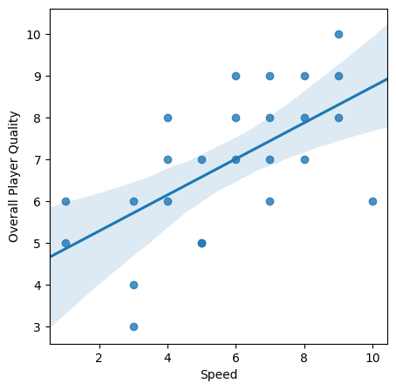
Phase I: Coach Assessment of Quality Depends on Speed and Skill
Corr: 0.800
Corr: 0.800
Coach’s assessment of player quality is heavily dependent on their perception of player’s skill and speed, but it is not correlated with coachability.

Slide 11
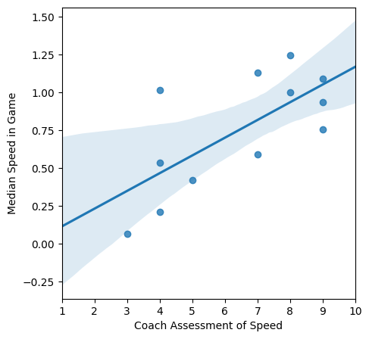
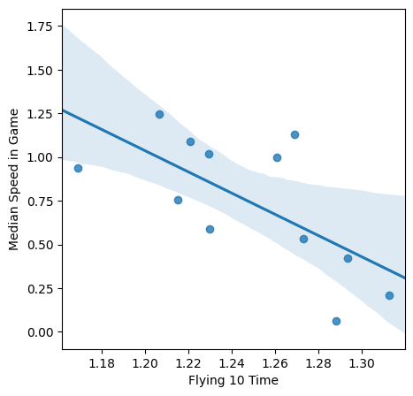
Phase I: Coach Assessment Supported by In-game Performance
Corr: 0.696
Corr: -0.667
Athletes’ in-game speed (from GPS) agrees with coach’s assessment of speed.

Slide 12
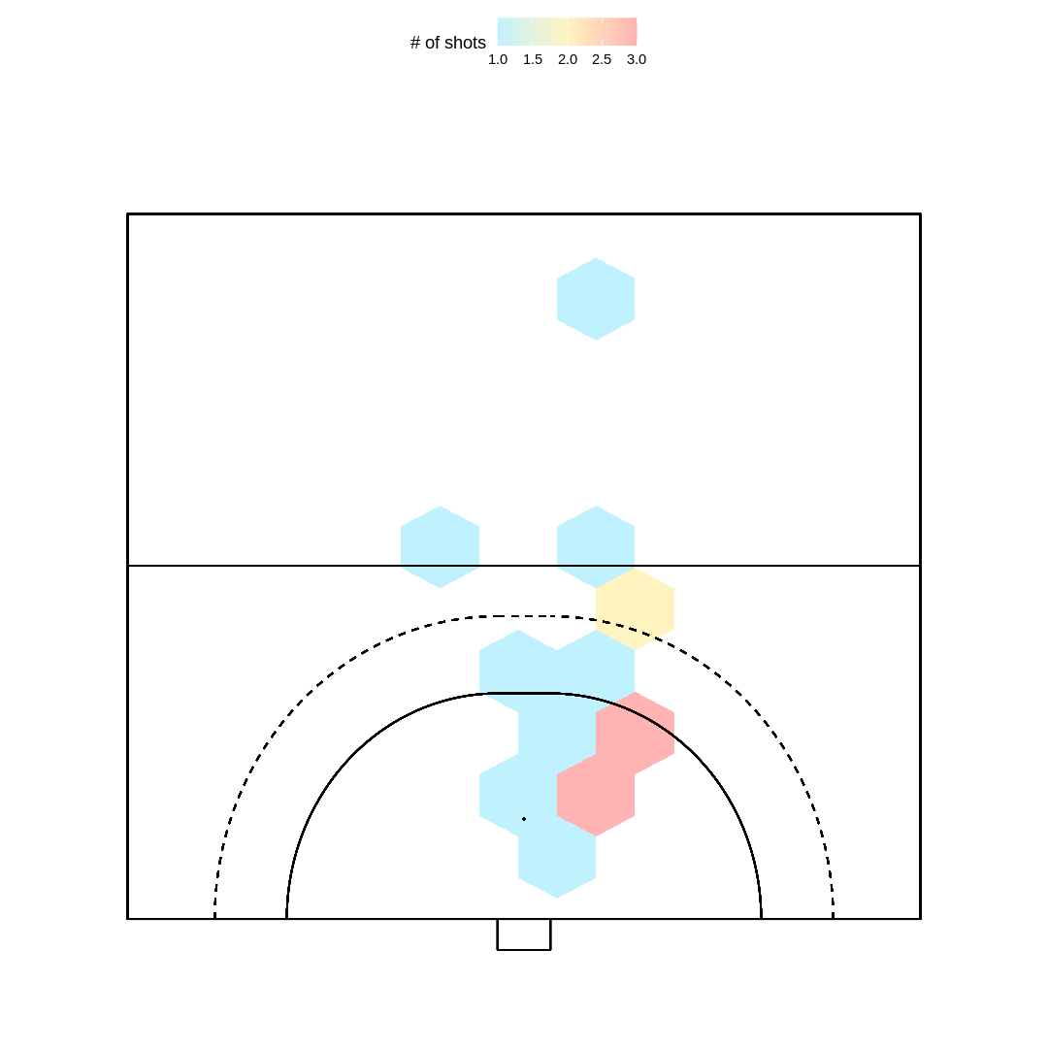
Phase II: Player Shooter Positions
Methodology: Compared GPS Data to the FH Events Data from 2022.
Takeaway:
Majority of shots from top-of the circle and from the right (Defender Goalie’s perspective).
These shots are taken 6 seconds prior to the shot occuring.
Caveats
Critical event timing often off from the GPS timing.
GPS Data from these home games: Delaware, Boston College, Brown, Columbia, LIU, Northwestern.
Notes:
error with the wrong trackers & timestamps
issues with shootouts, consistent use
origin of goals (SO, Set plays, outlets) etc.
remove bench from data points
review timestamps from jason to make hexbin
hexbin for all shots (approximate)
need EXACT times for critical events, turn on GPS all the same times, wear the same GPS devices
Andie: tile plot for location independent of time

Slide 13
Phase II: Player Positions Before Goals
Scorer Positions Before Goal (n=20)
All Player Positions Before Goal
Methodology: Compared GPS Data to the FH Events Data from 2022.
Takeaway:
Scorers favor shots from left side of circle, then top of the circle, then right (in order)
Multiple players tend to swarm the circle at the top left before scoring, but we don’t see similar swarming before other types of goals.
Individual snapshots of goals and circle entries are stored here for future use.
Caveats
Often missing GPS data for 1-4 athletes per game (Possible reasons: malfunctioning GPS).
Critical event timing often off from the GPS timing.
GPS Data from these home games: Delaware, Boston College, Brown, Columbia, LIU, Northwestern.
Notes:
error with the wrong trackers & timestamps
issues with shootouts, consistent use
origin of goals (SO, Set plays, outlets) etc.
remove bench from data points
review timestamps from jason to make hexbin
hexbin for all shots (approximate)
need EXACT times for critical events, turn on GPS all the same times, wear the same GPS devices
Andie: tile plot for location independent of time

Slide 14
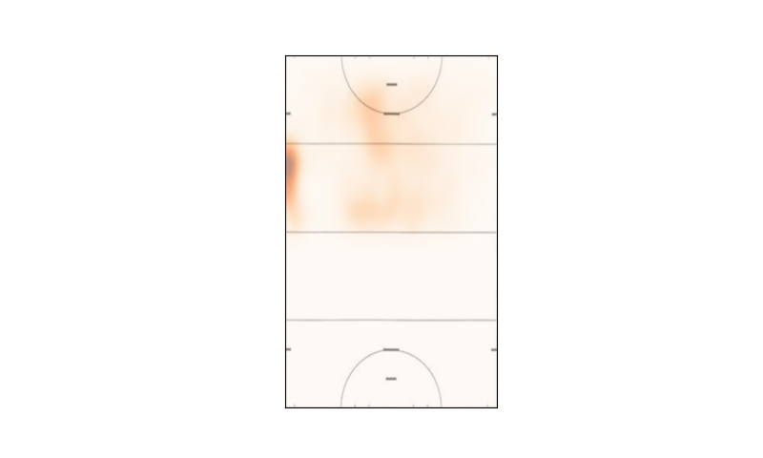
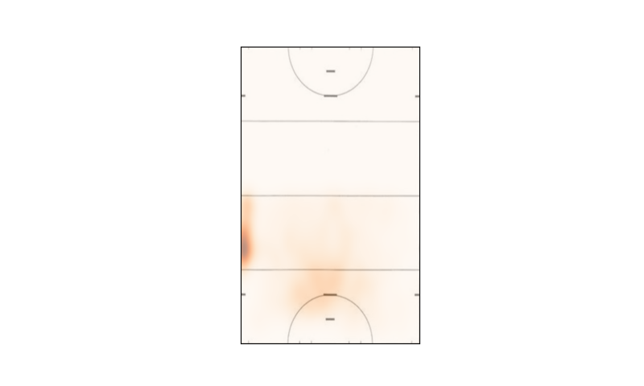
Phase II: Player Positions During Circle Entries
Player Locations: Circle Penetration
Player Locations: Def. Circle Penetration
Methodology: Created Heatmap of Player Locations before Circle Entries (CEs) based on GPS and Critical Event Data.
Takeaway:
Penn typically enters the circle from the same location where they secure most of their goals.
Penn rarely enters the circle from the sides.
Penn players typically clustered at the top of their own circle before giving up a circle entry (unknown where opponent enters from).
Individual snapshots of goals and circle entries are stored here for future use.
GPS Data from these home games: Delaware, Boston College, Brown, Columbia, LIU, Northwestern.
Notes:
error with the wrong trackers & timestamps
issues with shootouts, consistent use
origin of goals (SO, Set plays, outlets) etc.
remove bench from data points
review timestamps from jason to make hexbin
hexbin for all shots (approximate)
need EXACT times for critical events, turn on GPS all the same times, wear the same GPS devices
Andie: tile plot for location independent of time

Slide 15
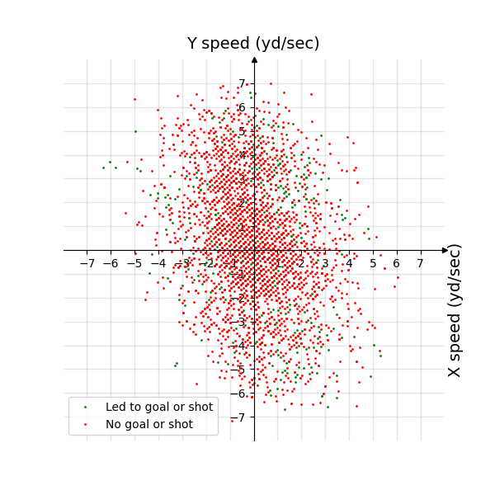
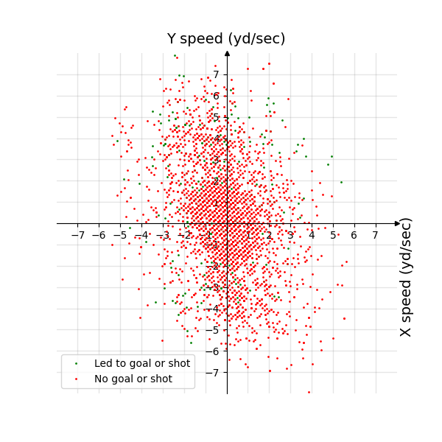
Phase II: Player Movements Before Circle Entries
Player Velocities Before
Defensive Circle Entries
Player Velocities Before
Offensive Circle Entries
Methodology: Looked at athletes’ velocity (vector) during Circle Entries (CEs).
Takeaway:
Athletes tend to move in the same direction before both types of circle entries.
Penn athletes move in more directions before Defense CEs.
Individual snapshots of goals and circle entries are stored here for future use.
GPS Data from these home games: Delaware, Boston College, Brown, Columbia, LIU, Northwestern.

Slide 16
Phase III: Player Position at Key Events with Computer Vision
Methodology: Developed computer vision model to evaluate Penn & Opponent player locations before Circle Entries during Northwestern and Columbia games
Takeaways:
Keeping adjacent player open and avoiding opponent ‘wall’ is key to a shot on goal
Shots on goal have a good conversion rate (30.4%), but nearly identical to opponents (29.3%)
Recommendations for the future:
Mount stationary camera with view of entire field (horizontally) for more accurate data.
Precise timestamp in corner of video will improve syncing with key events like goals.

Slide 17
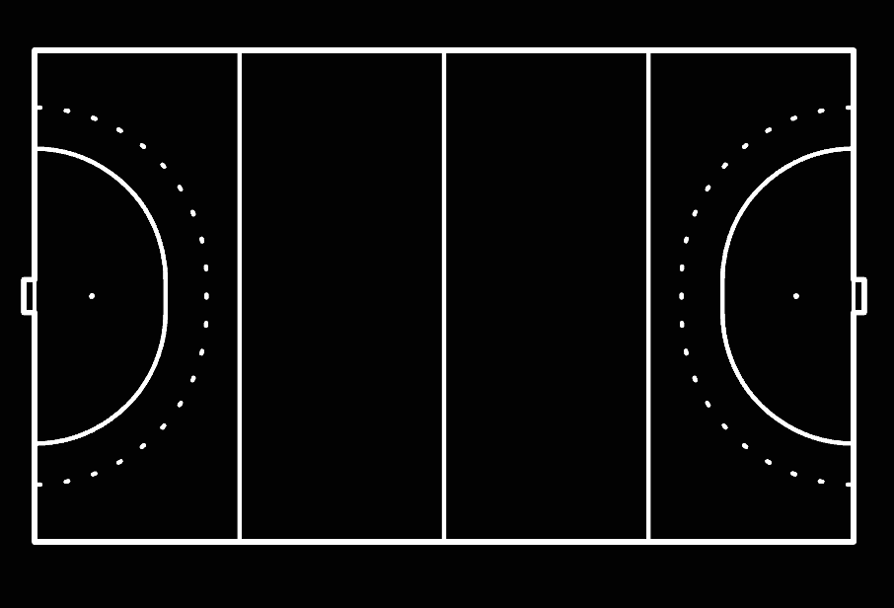
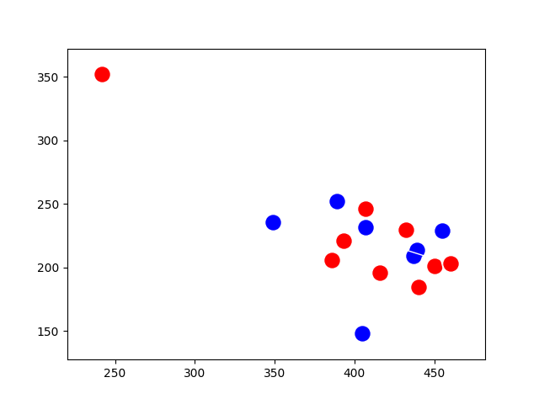
Phase III: Columbia v. Penn Circle Entries
Observations
3 Penn players approach circle as a “wall” with the ball holder behind - help overwhelm defense by being distributed along circle
3 Penn players on the circle are several feet apart, leaving bottom player open for a pass that eventually leads to goal
Rest of Penn team blocks rest of defense effectively
Penn Circle Entries - Resulted in Goal
(Penn in blue, ball holder in green)
Notes:
show goal location
fix the graphs with colors and areas of domination
heat maps and images for set plays
possible MP4s of the set plays

Slide 18
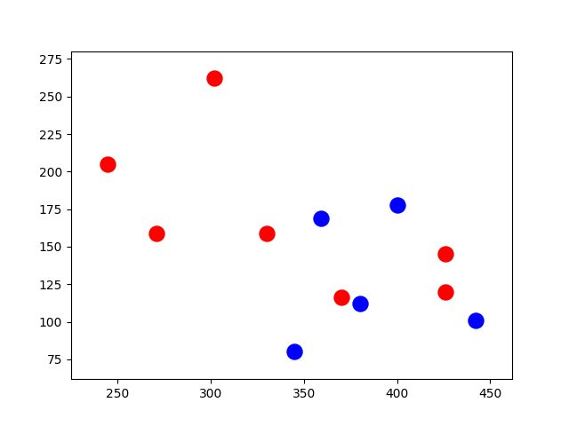
Phase III: Columbia v. Penn Circle Entries
Observations
Single Penn player enters circle, easily blocked by single defender
Ball holder is ahead of most of the team and right next to 2 unblocked, well-positioned defenders, making passing difficult
Other Penn players are still catching up, meaning defense has more time to chase ball holder
Penn Circle Entry - Did Not Result in Goal
(Penn in blue, ball holder in green)
Notes:
show goal location
fix the graphs with colors and areas of domination
heat maps and images for set plays
possible MP4s of the set plays

Slide 19
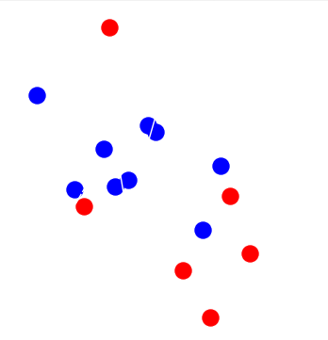
Phase III: Northwestern v. Penn Circle Entries
Observations
There are more Penn players than Northwestern players, so a goal shot was possible.
Ball holder was engaged directly by a Northwestern player, which puts them under pressure.
The other four Northwestern players have formed a “box” in front of the net which allows them to protect the front of the net against rebounds and prevent a clear shot to the net if the ball holder passes to a teammate.
Penn Circle Entry - Goal Shot, But No Goal
(Penn in blue, ball holder in green)
Notes:
show goal location
fix the graphs with colors and areas of domination
heat maps and images for set plays
possible MP4s of the set plays

Slide 20
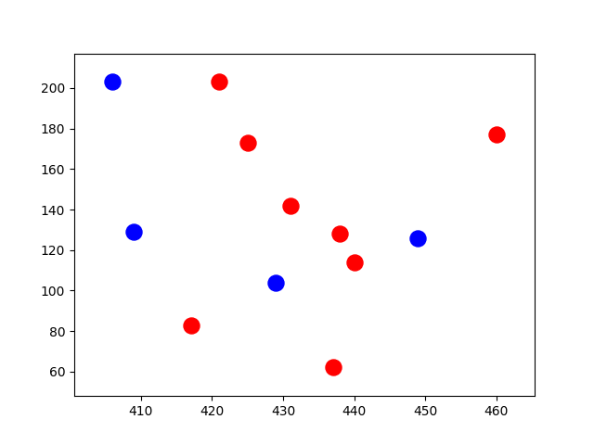
Phase III: Northwestern v. Penn Circle Entries
Observations
There are more Northwestern players than Penn players, so a goal shot was not possible.
Ball holder was not engaged directly by a Northwestern player, but all passing options were covered.
Six Northwestern players formed a “wall” that prevented any shots or passes from getting through to the open player in front of the net as well as any player in their vicinity.
Penn Circle Entry - No Goal Shot
(Penn in blue, ball holder in green)
Notes:
show goal location
fix the graphs with colors and areas of domination
heat maps and images for set plays
possible MP4s of the set plays

Slide 21
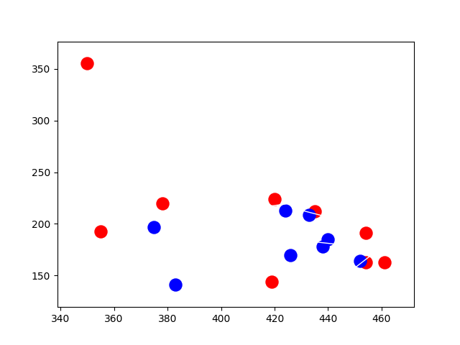
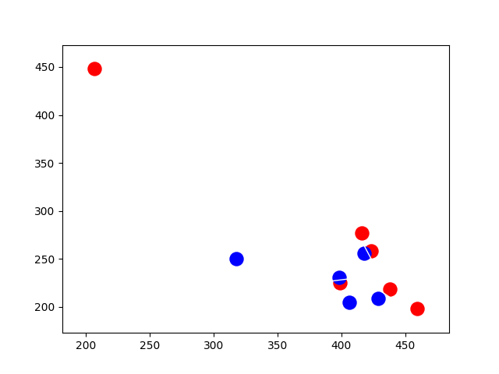
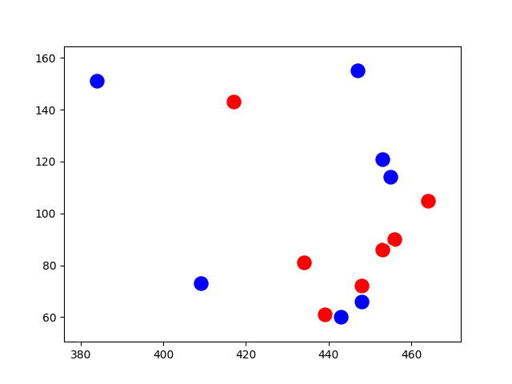
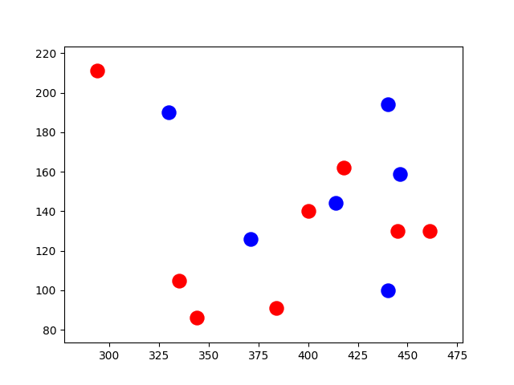
Analysis: Further Circle Entry Examples
Penn Circle Entry - Did Not Result in Goal
(Penn in blue, ball holder in green)
Penn Circle Entry - Resulted in Shot on Goal
(Penn in blue, ball holder in green)
(Shot blocked by goalie)

Slide 22
Analysis: Further Circle Penetration Examples
No Goal Shot (Penn Blue, Northwestern Red)

Slide 23



Slide 24
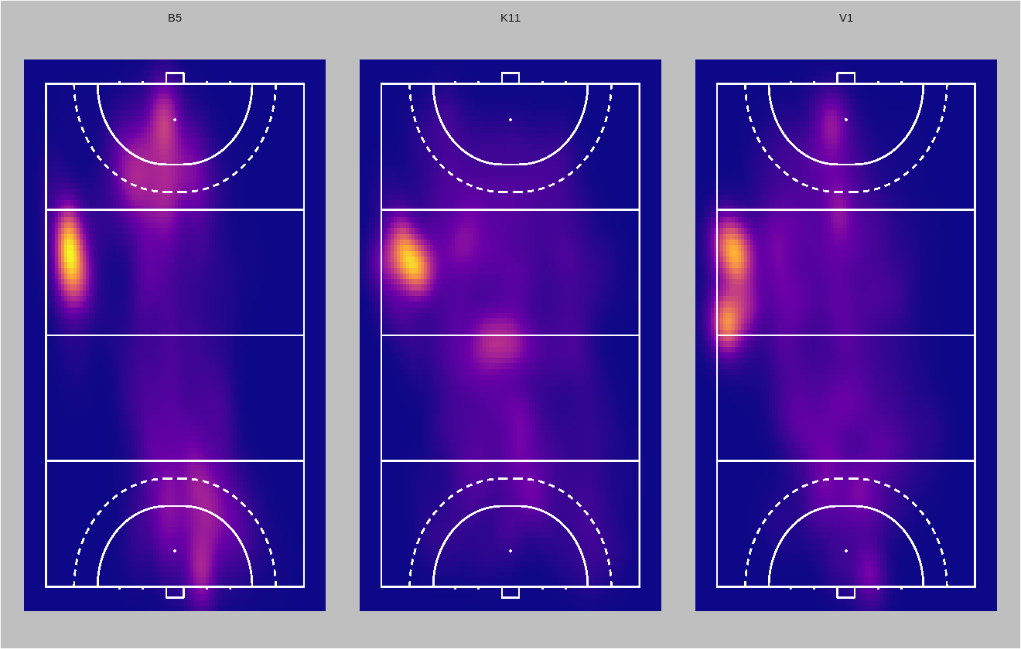
Phase II: Players’ Location Throughout Home Games

